Slide 1
Introduction to Everyman

Slide 2
VISION & PURPOSE
VISION
EveryMan supports men with high and complex needs to create a world that works for them, their families and the communities in which they live.
PURPOSE
To bring effective and professional services to men experiencing exclusion, discrimination and marginalisation no matter who they are or what they have done.

Slide 3
OUR VALUES
Authenticity
We care that we are who we say we are, and we do what we say we’ll do.
Responsibility
We act to cause outcomes, and we own the outcomes and consequences.
Commitment
We go all in to honour the promises and agreements we make, and we appropriately demand the same of others
Accountability
We assume full ownership for the promises and agreements we make - our word has value.
Tenacity
We bring determination and perseverance to challenging circumstances to achieve the outcomes we have committed to for the people we work with.
Partnership & Contribution
We join with others who share our values and commitments to be of service to each other and cause outcomes that would not be achieved alone.

Slide 4
OUR HISTORY
In 1991, a small group of men established a counselling and advisory service for men under the name of “Murringu Counselling and Advisory Service”
From 1992 to 1994, Murringu ran a series of workshops on themes related to men and masculinity and began offering a weekly drop-in in rooms at St John’s Church in Reid.
In 1996-97 Murringu received a grant of $15,000 towards operating a counselling and referral Centre for men.
In 1998 Gerald Franks and Greg Aldridge joined the Management and began to turn the organization into a community service provider.
In 2002, Murringu received $70,000 annual funding to run a case management program in Ainslie Village.
In mid-2004, Murringu successfully tendered for what is now the MASS program. In July 2004 Murringu began providing accommodation, case management and outreach support to men with complex needs who were homeless or at risk of homelessness.

Slide 5
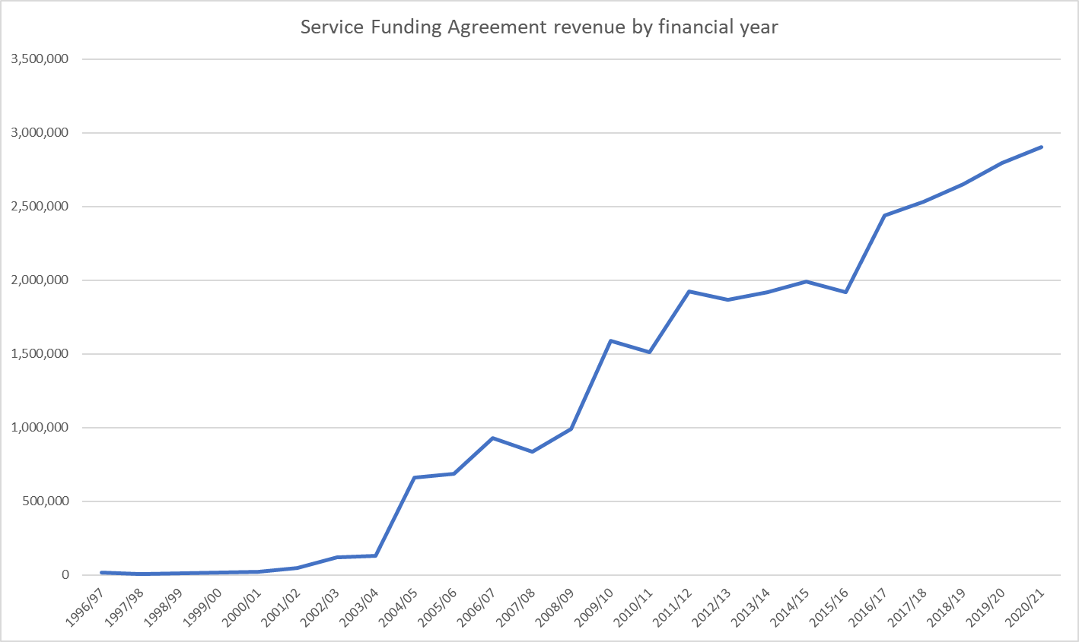
OUR HISTORY
In September 2004, Murringu changed its name to “Canberra Men’s Centre”.
In 2007 increased Counselling Services funding from $57000 to $200,000
In 2009 doubled the size of the MASS program to support men with complex needs exiting the justice system.
In 2011 established the Working With the Man program.
On 04 December 2015 changed our name to “EveryMan Australia Inc.”.
In 2015 partnered with Toora Women to established EveryMan’s Indigenous Support and Accommodation program.
Our Funding History

Slide 6
EVERYMAN TODAY
Our organisation and our services

Slide 7
BOARD OF DIRECTORS
EveryMan Australia is incorporated under the Associations Incorporation Act 1991, which makes us accountable to the ACT community. This means we’re on the public record - providing a legal framework for our operations and activities, our financial affairs, our status as an association and identifying the people responsible for the governance of the organisation.
The Board’s role is to help forward EveryMan’s vision and mission in the ACT, working to ensure the organisation is well supported by sound governance practice.

Slide 8
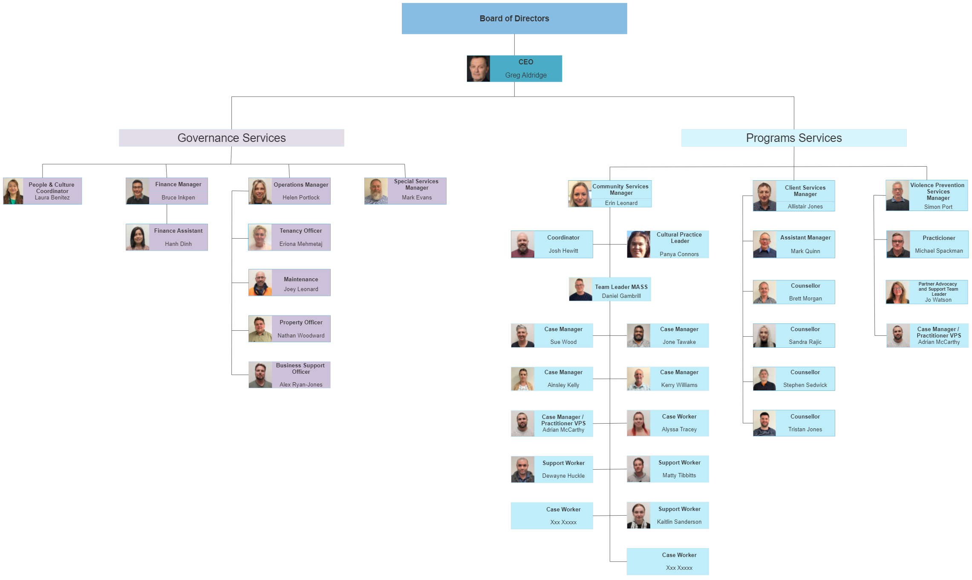
ORGANISATIONAL CHART

Slide 9
CEO MANAGEMENT RESPONSIBILITIES
Implementing governance policy (the will of the Board)
Day to day management of the organisation and programs
Risk management
Financial management
HR and workforce management
Quality assurance
Stakeholder relationships
Reputation management
Operational policy and procedure

Slide 10
OUR CHIEF EXECUTIVE OFFICER
He works with EveryMan since 2004 and he is Member of Domestic Violence Prevention Council since 2006.
Greg Aldridge is a registered Psychologist since 1984. He has skills in organisation and program management, complex case management, individual, family and relationship counselling and family therapy.
He specialise in working with domestic and family violence, child abuse and neglect (victims and perpetrators).

Slide 11
OPERATIONS
For EveryMan, Operations incorporates two separate but overlapping areas of administration:
1. The organisation
Includes all the necessary to operate internally, e.g.:
Office services - office security, cleaning, repairs and maintenance, tenancy, storage, purchasing
Communications - reception, internal messaging, email, social media
Information and communications Technology - mobiles, computer network, phones.
Financial services (accounts payable, petty cash, donations and receipts from clients, insurances)
Board secretariat.
Activities which support client service delivery, e.g. :
Occupancy/rent/property management, inc property allocation, maintenance
Managing Smartsheet reporting systems for supervision, team meetings, monthly reports, client surveys, incidents and accidents
Feedback and complaints reporting and response management
Other support to programs as required
2. Program operations

Slide 12
PEOPLE & CULTURE
Employee Life Cycle – Attraction, Recruitment, Onboarding/ Induction, Development, Performance Management, Cessation
Workplace Diversity
WH&S, Well-being
All Related Policies and Procedures
Discipline, Code Of Conduct, Performance Management
Coaching Managers and Coordinators
Workplace Culture, Inc. Officevibe

Slide 13
CLIENT SERVICES
These are the programs where our clients get access to support:
Counselling Services – for men of all ages, and their partners and families.
Men’s Accommodation and Support Services (MASS) – supported accommodation and case management for men with complex needs (mental health, AOD, intellectual disability, ABI, involvement in justice system).
Indigenous Support and Accommodation (ISA) – community housing and boarding house programs for individuals and families.
Violence Prevention Services - Working With the Man (WWM) behavior change program and ‘Preventing Violence, Managing Anger’ group.

Slide 14
EVERYMAN IS A NDIS PROVIDER
If you work in MASS/ISA or Counselling, you might be providing services to a client under the NDIS.
If so, there is some important information you need to know and training you are required to undertake. You will receive this important information as part of the Induction with your manager/supervisor.
You should also read the following:
NDIS Code of Conduct – click on the link
NDIS (Incident Management and Reportable Incidents) Rules 2018 – click on the link
NDIS Reportable Incidents Guidance – click on the link
NDIS (Quality and Safeguards Commission) Rules Summary – click on the link
Keep the above resources handy, as they will help you when you are having your detailed NDIS Induction with your manager/supervisor.
If you are unsure about anything you read in these resources or have any queries relating to them, you should raise this with your manager/supervisor during your NDIS Induction.

Slide 15
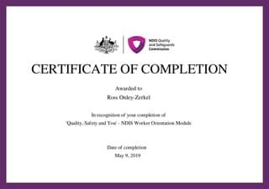
EVERYMAN IS A NDIS PROVIDER (CONT.)
You must also complete two on-line training modules. Ideally, you should complete this training within the first week of commencing work and definitely prior to working with any NDIS clients.
Please click on this link It will take you to the NDIS Quality and Safeguards Commission website. Please complete both the following modules:
“Quality, Safety and You”
“Training for NDIS Workers during COVID-19”
You should receive a Certificate of Completion for each course. Please download and save the Certificates and send them to your manager/supervisor.
Xxxxx Xxxx

Slide 16
EVERYMAN RESOURCES
Staff page (resources list, client lists) link
Operational Policy and Procedures manual link
Social, Community, Home Care and Disability Services (SCHADS) award link
Google calendar
Slack (virtual workspace)
Smartsheet, Dropbox
iPhones and iPads
Team meetings, supervision, case reviews
Client databases: IVO, Specialist Housing Information Platform (SHIP)

